Slide 1

RESUME CLASSIFICATION
Mentor Name: Mr. Adhvaith
Team Members:
1.) Mr. Naimish Wankhede
2.) Mr. Divyanshu Sharma
3.) Mr. Akhand Chitransh
4.) Mr. Rushikesh Nere
5.) Ms. Pooja Patil
6.) Ms. Sushmita
7.) Mr. Dashrath

Slide 2
Business Objective
The document classification solution should significantly reduce the manual human effort in the HRM .It should achieve a higher level of accuracy and automation with minimal human intervention.

Slide 3
PROJECT ARCHITECTURE :
Collection of Data
Business Understanding
Exploratory Data Analysis(EDA)
Deployment
Model Building

Slide 4
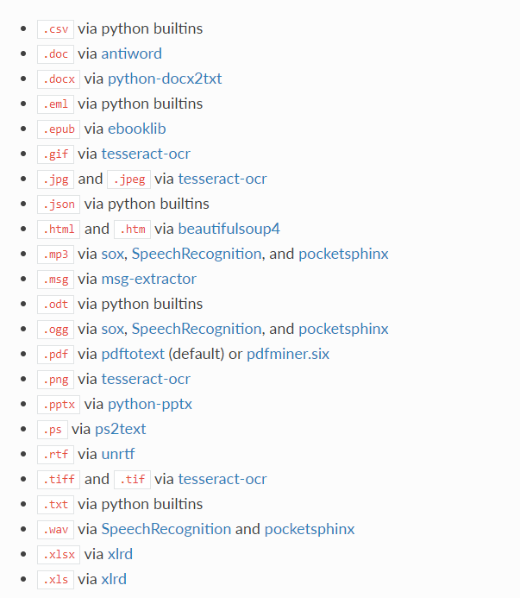
Textract :
This package provides a single interface for extracting content from any type of file, without any irrelevant markup.

Slide 5
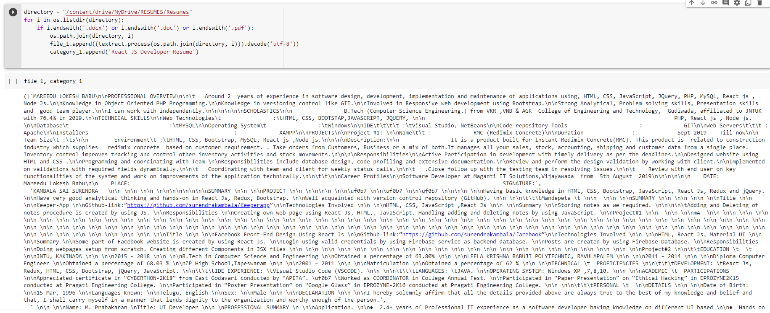
Converting all file to .txt (Process)

Slide 6
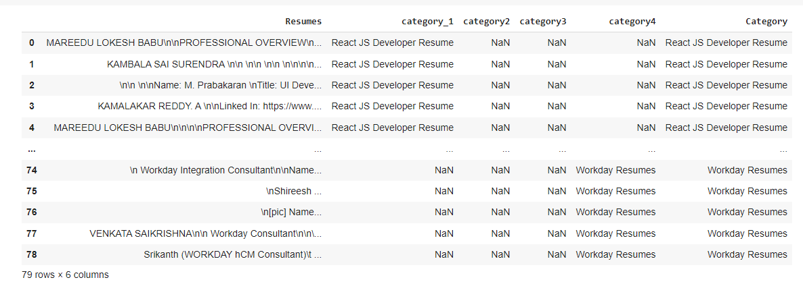
Merging all category files:

Slide 7
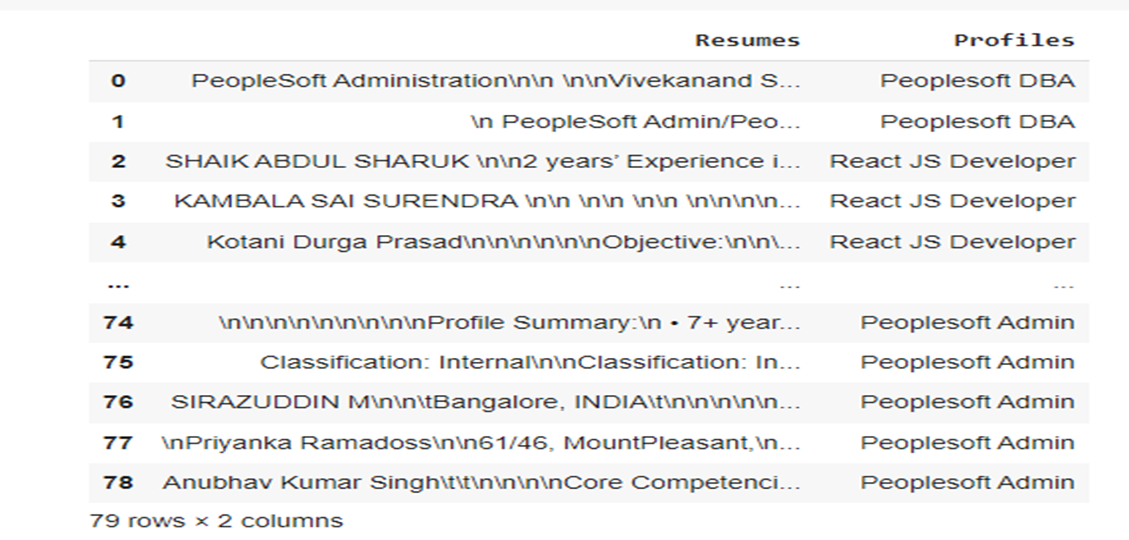
Converting text to .csv (Process)

Slide 8
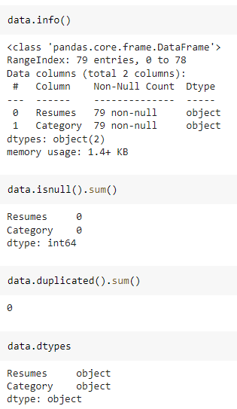
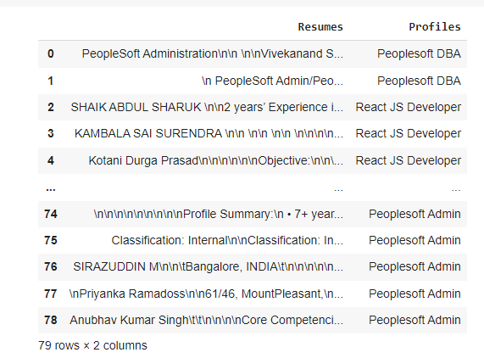
Data Set Details
After Extracting and Modifying the Dataset, given data contains a total of 4 Classes and 79 rows .

Slide 9
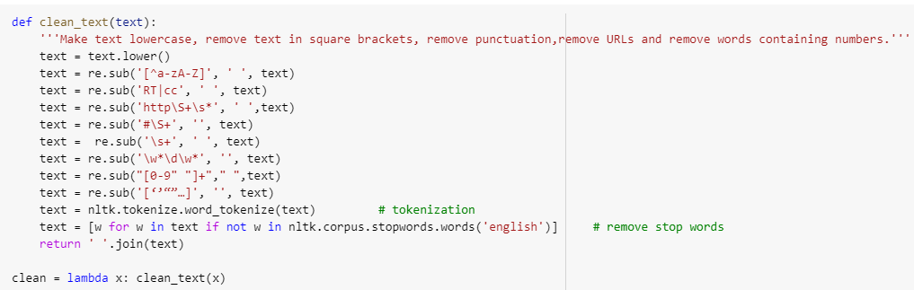
Removing All Unwanted Character’s :
Unwanted Character’s like - \n \t, http links, tags, hashtags, html tags, converting to lower case, removing white spaces etc.
Word Tokenization - Tokenization is essentially splitting a phrase, sentence, paragraph, or an entire text document into smaller units, such as individual words or terms. Each of these smaller units are called tokens.
Removing Stop-words - A stop word is a commonly used word (such as “the”, “a”, “an”, “in”) that a search engine has been programmed to ignore, both when indexing entries for searching and when retrieving them as the result of a search query.

Slide 10
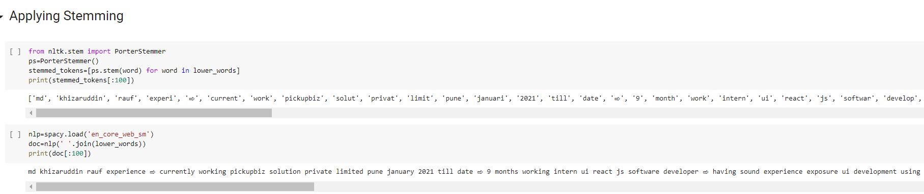
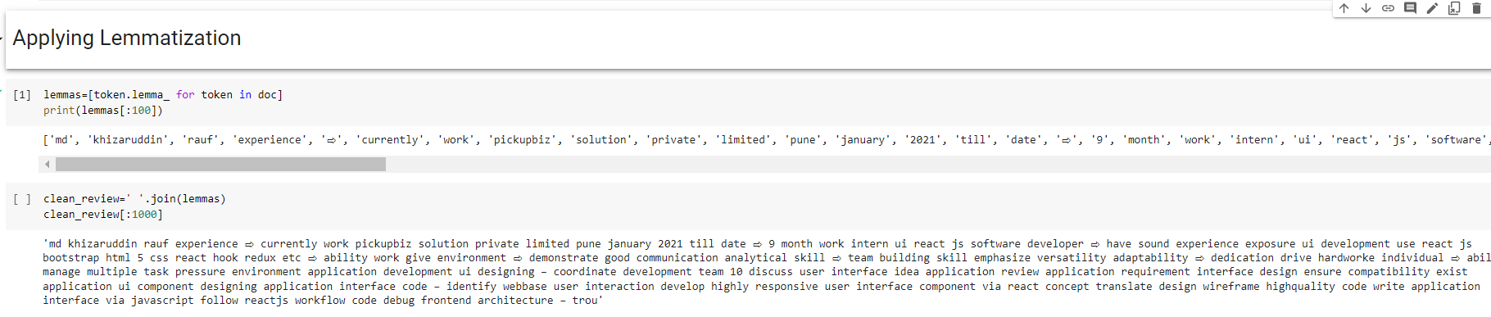
Text – Preprocessing :
The Porter stemming algorithm (or 'Porter stemmer') is a process for removing the commoner morphological and inflectional endings from words in English.

Slide 11
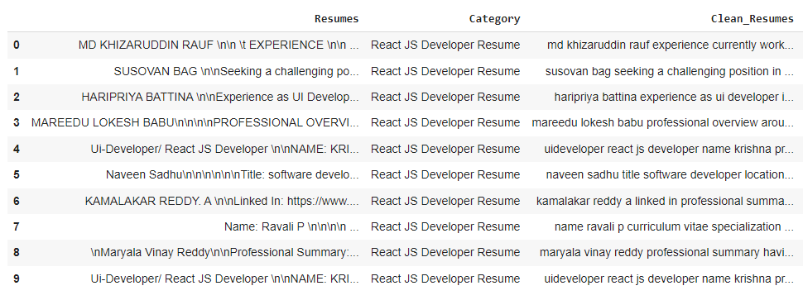
Text – Preprocessing :
In natural language processing, text preprocessing is the practice of cleaning and preparing text data. NLTK and re are common Python libraries used to handle many text preprocessing tasks.
Before Text – Preprocessing After Text – Preprocessing
The Dataset contains 79 rows and 3 Column
There are total four Classes – Peoplesoft, Workday, React JS Developer and SQL Developer.

Slide 12
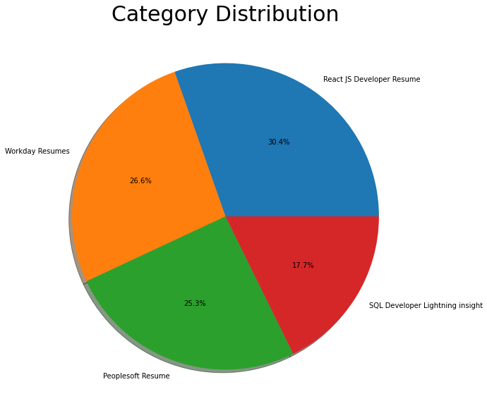
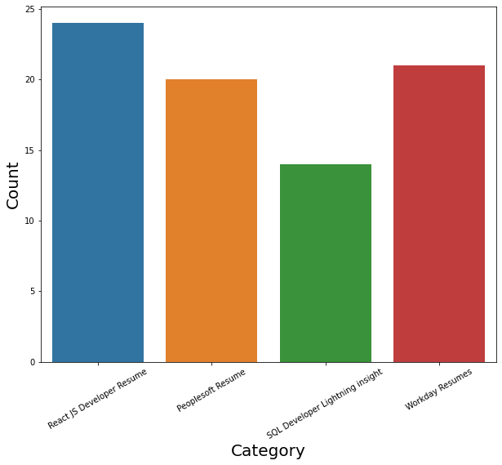
Labels :
By using Pie chart roles applied feature is displayed to visualize the job roles.
By using Histogram roles applied feature is displayed to check the job types.

Slide 13
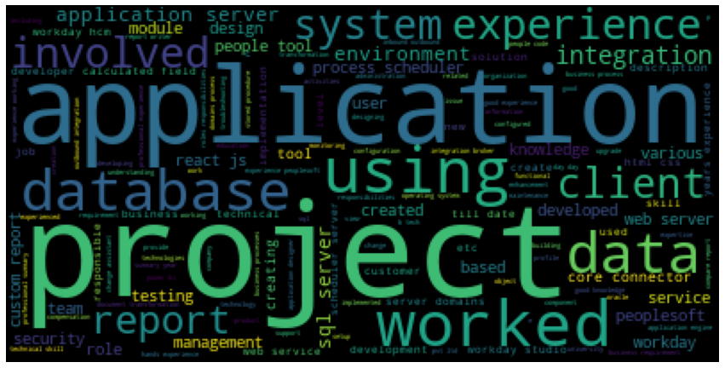
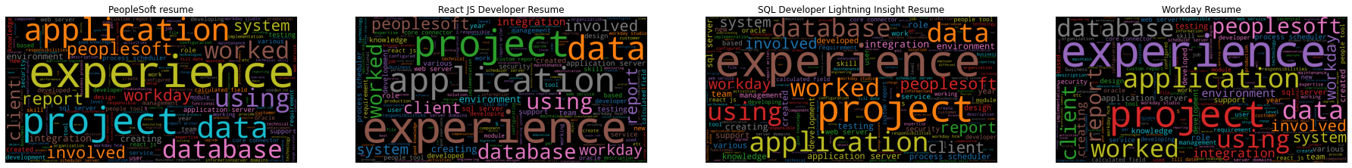
Word cloud :

Slide 14
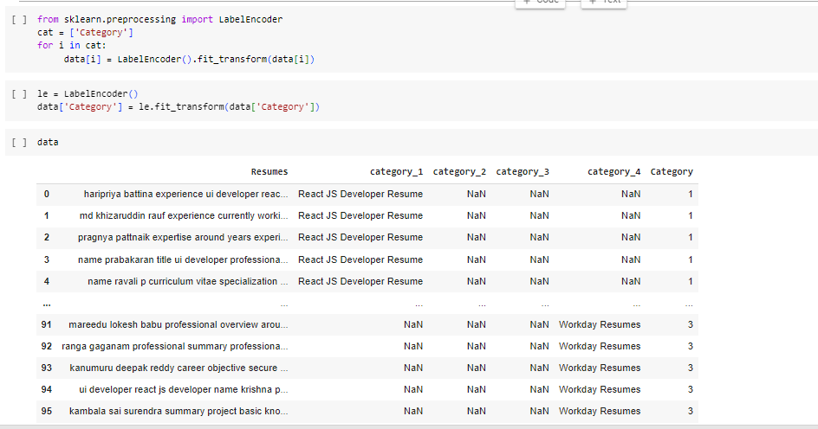
LabelEncoder :

Slide 15
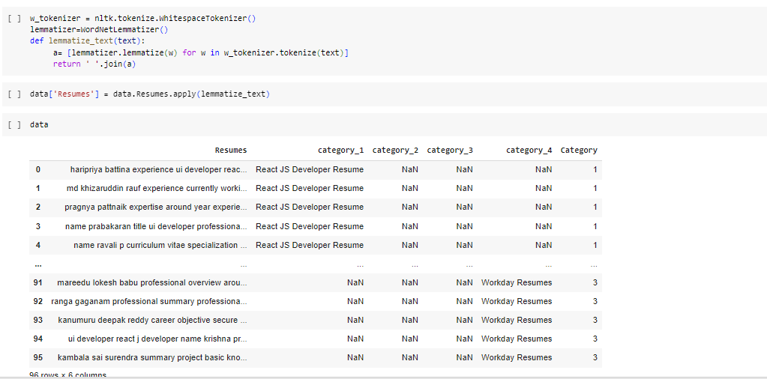
Tokenizer :

Slide 16
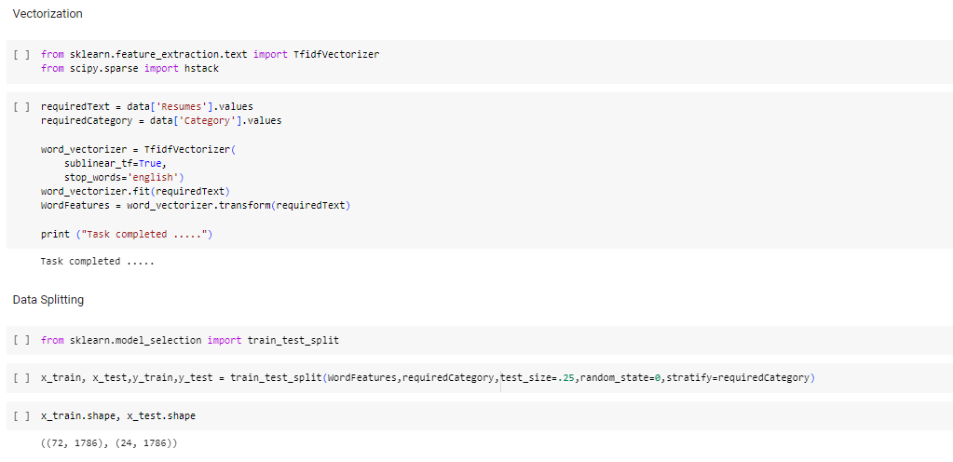
Vectorization :

Slide 17
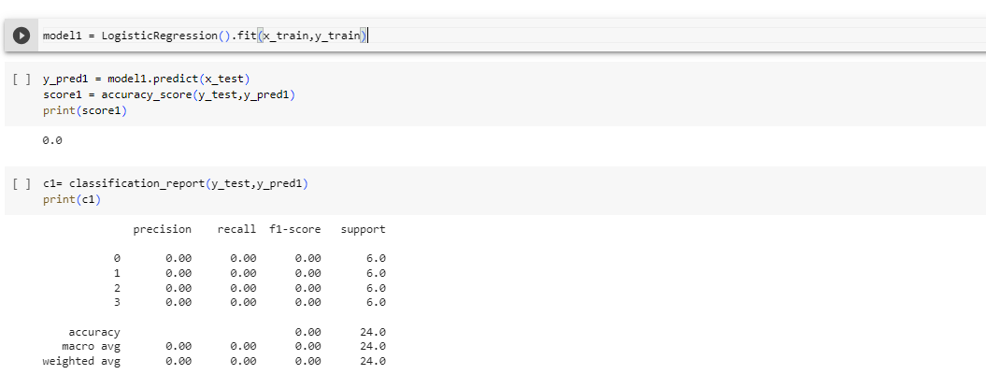
Model Building : Logistic regression

Slide 18
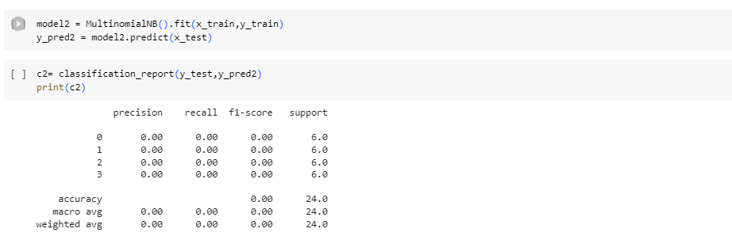
Multinomial Naive Bayes :

Slide 19
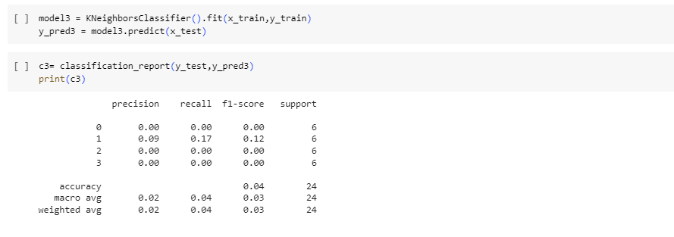
KNeighborsClassifier :

Slide 20
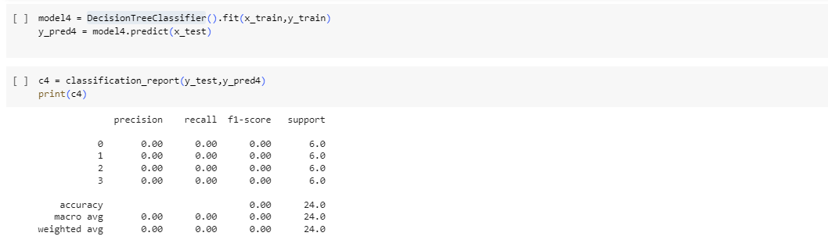
Decision Tree Classifier:

Slide 21
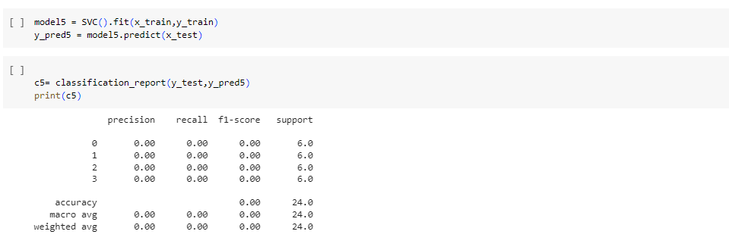
Support Vector Classifier:

Slide 22
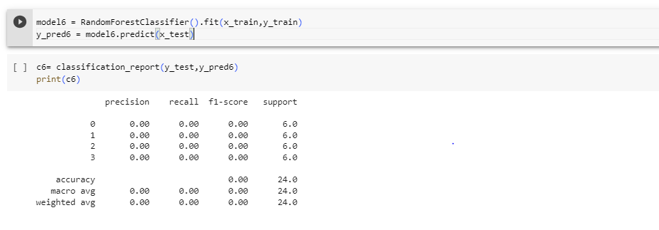
Random Forest Classifier :

Slide 23
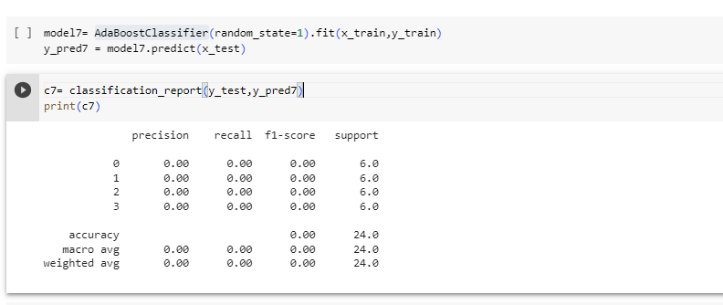
AdaBoostClassifier :

Slide 24
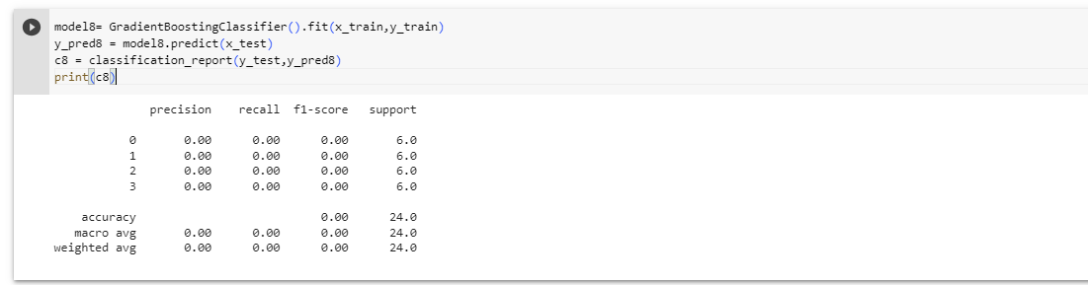
Gradient Boosting Classifier :

Slide 25
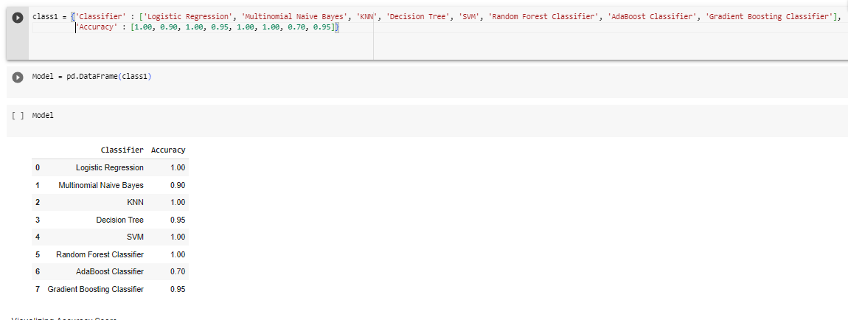

Slide 26
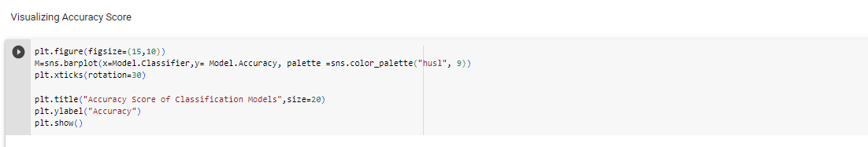
Visualizing Accuracy Score :

Slide 27
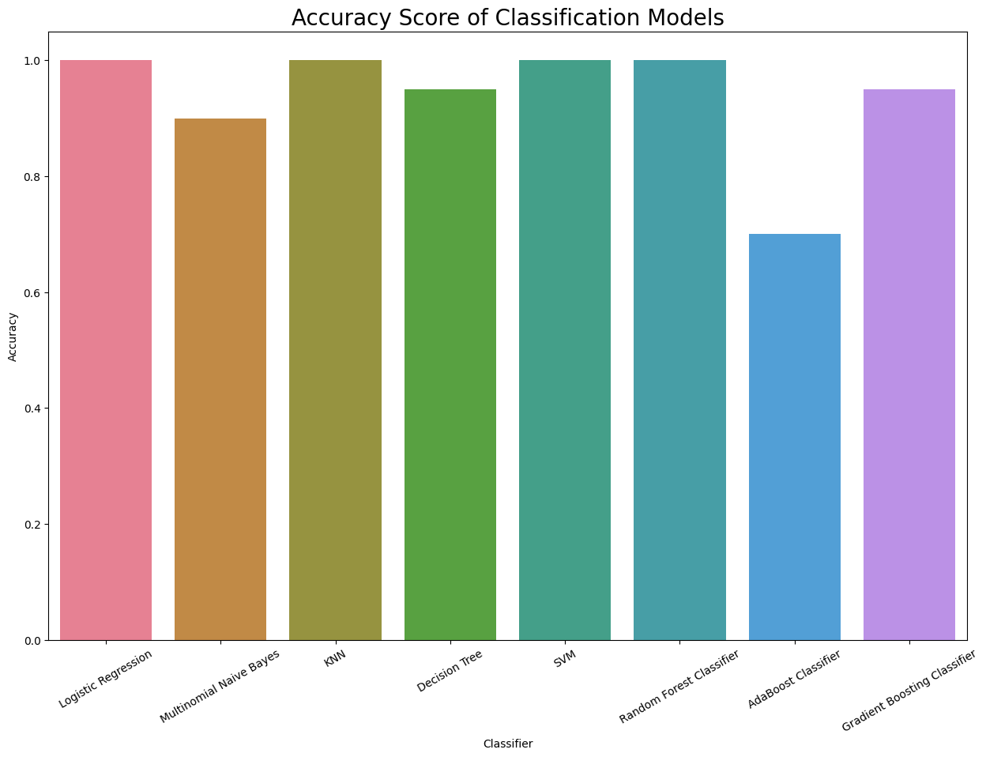

Slide 28
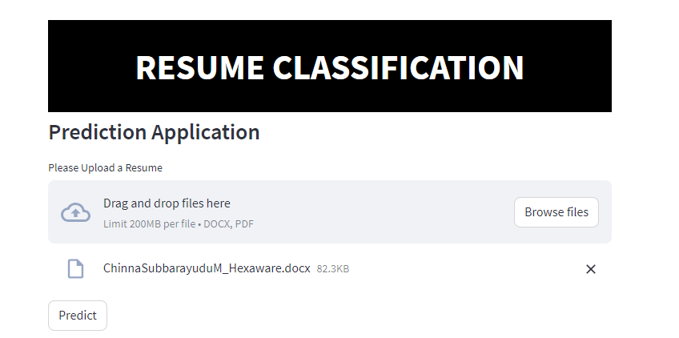
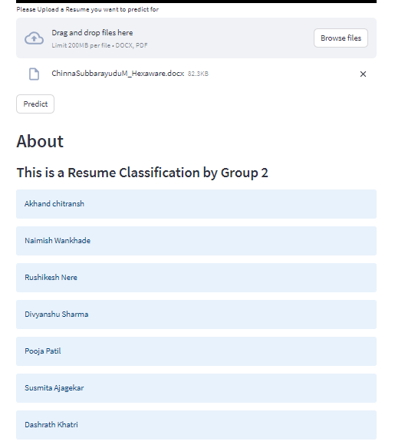
Project Deployment :
Deployment is the process by which the document types, model, and overall project definition are made available for use.

Slide 29
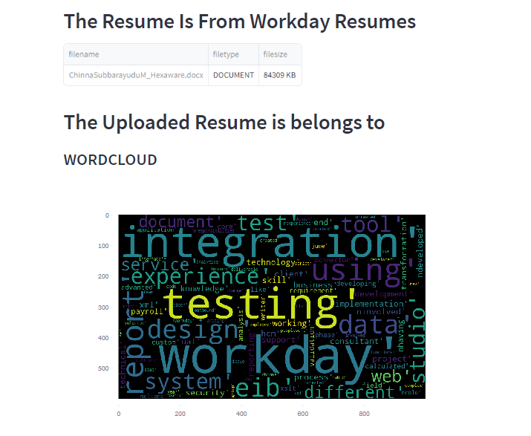

Slide 30
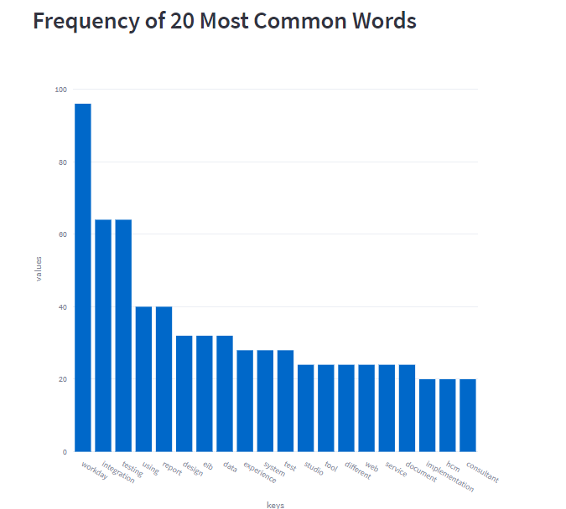

Slide 31
Thank you

